Slide 1


“Banking Management System”
Submitted by Team 03
Ashok Kumar
Chinmay M
Raghu H S
M. Suma Rani
From HARMAN C++ Batch 06

Slide 2


Table Of Contents
Contents | Slide Number
ABSTRACT | 3
INTRODUCTION | 4
PROPOSED SYSTEM | 5
SYSTEM REQUIREMENTS | 6
BACKGROUND | 7
MODULE DESCRIPTION | 8-9
UML DIAGRAMS | 10-12
SNAPSHOTS | 15-19
CONCLUSION | 20

Slide 3
ABSTRACT
The Bank Management System is an application for maintaining a person's account in a bank. In this project we tried to show the working of a banking account system and cover the basic functionality of a Bank Management System. To develop a project for solving financial applications of a customer in banking environment. The main aim of this project is to develop software for Bank Management System. This project has been developed to carry out the processes easily and quickly, which is not possible with the manuals systems, which are overcome by this software.

Slide 4
INTRODUCTION
The “Bank Management System” project is a model Internet Banking Application. This enables the customers to perform the basic banking transactions by sitting at their office or at homes through PC or laptop.
The system provides the access to the customer to create an account, deposit/withdraw the cash from his account, also to view reports of all accounts present.
The customers can access the banks website for viewing their Account details and perform the transactions on account as per their requirements.
With Internet Banking, the brick and mortarstructure of the traditional banking gets converted into a click and portal model, thereby giving a concept of virtual banking a real shape.

Slide 5
PROPOSED SYSTEM
In our proposed system we have the provision for adding the details of the customers by themselves. Another advantage of the system is that it is very easy to edit the details of the customer and delete a customer when it is unnecessary.
Our proposed system has some advantages:
User friendly interface
Fast access to database
Less error
More storage capacity
Search facility

Slide 6
REQUIREMENTS
Hardware Requirements:
● Processor: Intel P-IV System
● Processor Speed:250 MHz to 833 MHz
● Ram: 512 Mb Ram
● Hard Disk : 40 GB
Software Requirements:
● Window/Linux Based OS/Mac OS/ Any OS capable of running C++
● MySQL database
● XAMPP server
● Code::Blocks IDE

Slide 7
Background of the project
Creating a database for organizing and storing data received through web applications with bank customer data. And for fetching the most recent data from the database (Clients Database). The data stored in the DB must be organized and maintained in such a way it caters to the needs of the future. All the customer data are viewed in an arranged manner according to the registered account numbers.

Slide 8
Module Description
01
Create Account
Opens the new account for the users by accepting input such as name, account type, account number and minimum balance
02
View Account
This helps to view all the bank accounts that are created
03
Deposit Amount
Provide the options to deposit amount to the given account number
04
Withdraw Amount
Provide the options to withdraw amount from the given account number
05
Balance Enquiry
Displays bank balance of particular account

Slide 9
06
Account Holder List
This option helps to view all the bank accounts in the database
07
Close Account
Cancels/Close the selected account from the bank
08
Logout
This helps to get logout from the account
09
Exit
This option is to get exit

Slide 10
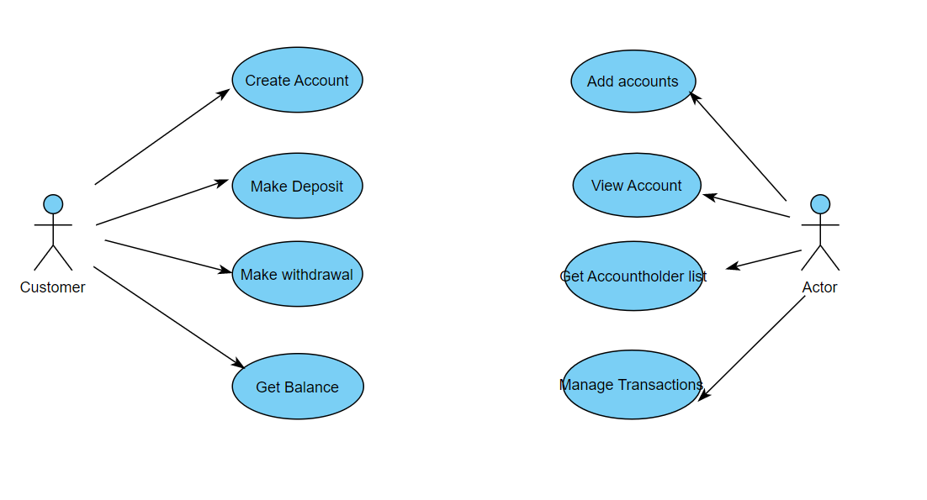
UML Diagrams
Use Case Diagram

Slide 11
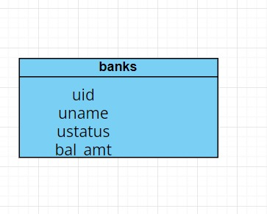
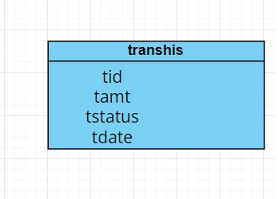
Database Tables

Slide 12
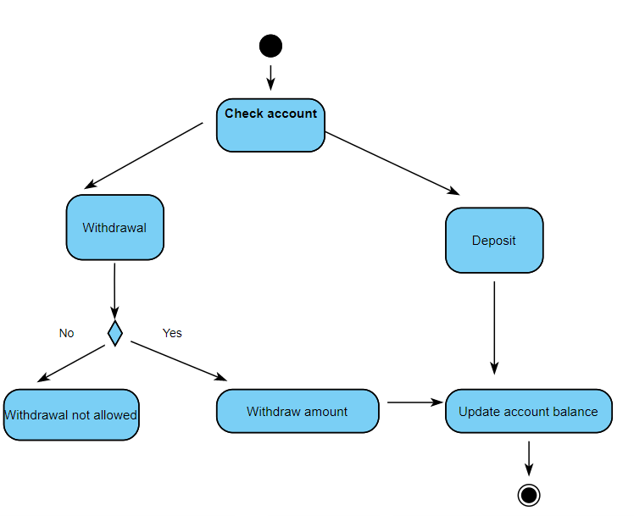
Activity Diagram

Slide 13
How does the application work?
The Basic Bank Management System is a simple console program that allows you to access all of the system’s features by entering the system password.
The user has several options in the system, including creating new client accounts, depositing cash, withdrawing cash, and changing account information.
The system will offer you the tools you need to manage your bank accounts. Your data will be saved as a data file extension by the system.

Slide 14
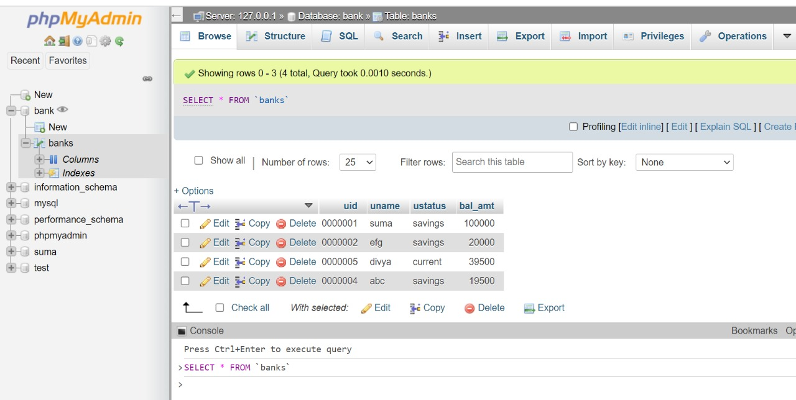
Database

Slide 15
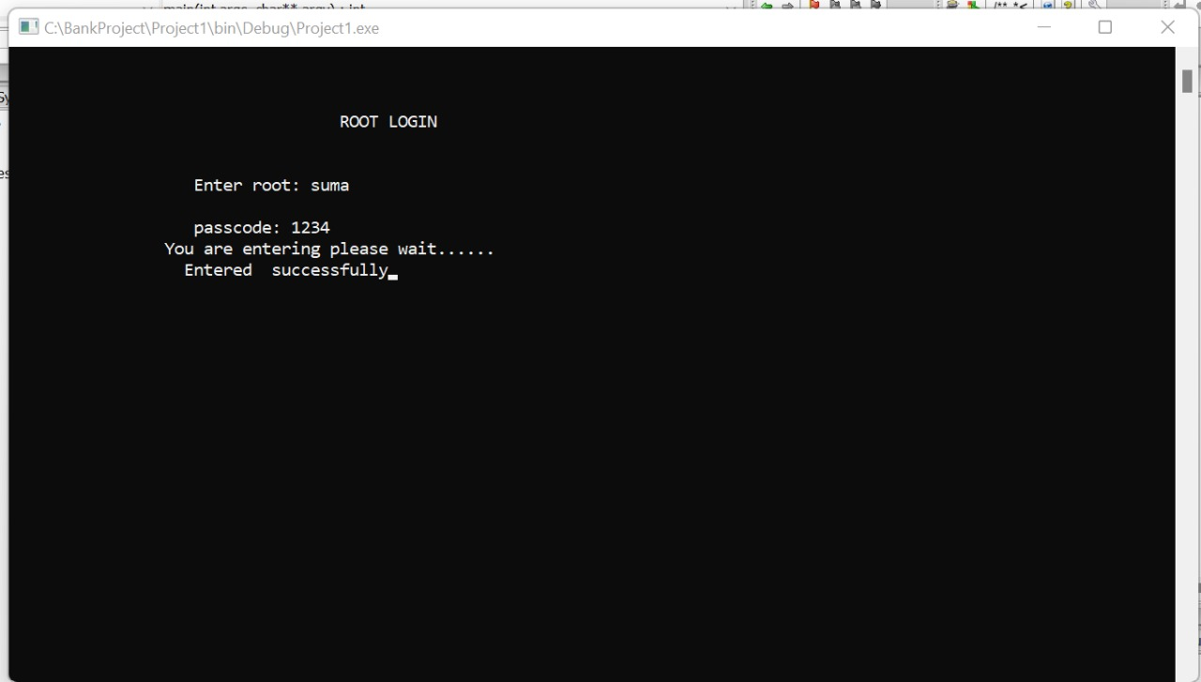
Snapshots Of our Application
Root Login

Slide 16
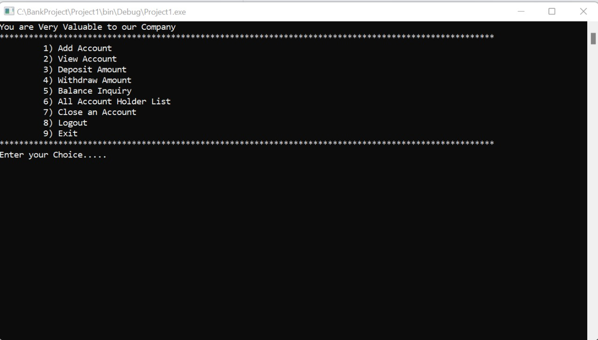
Home Console

Slide 17
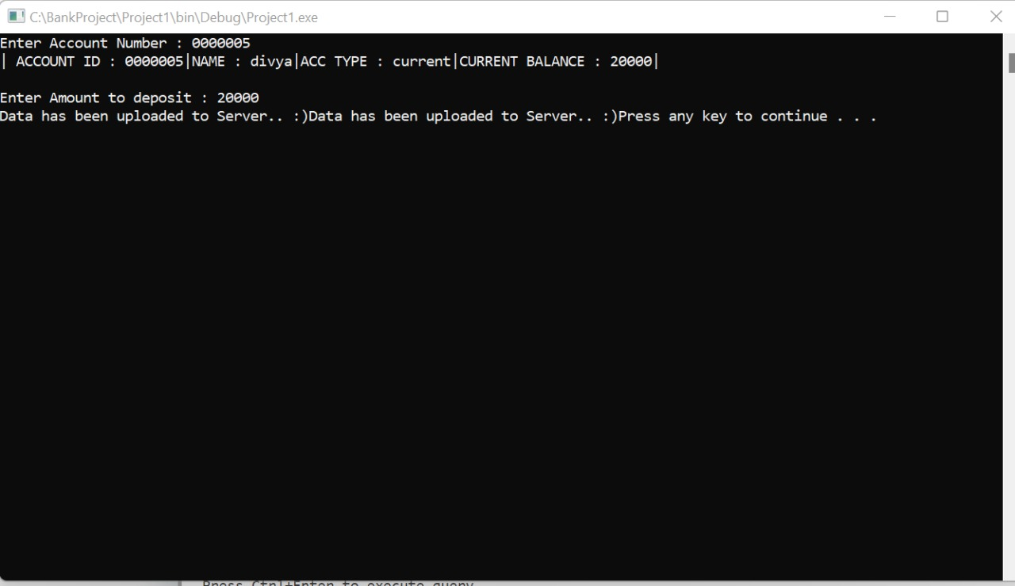
Amount Deposit

Slide 18
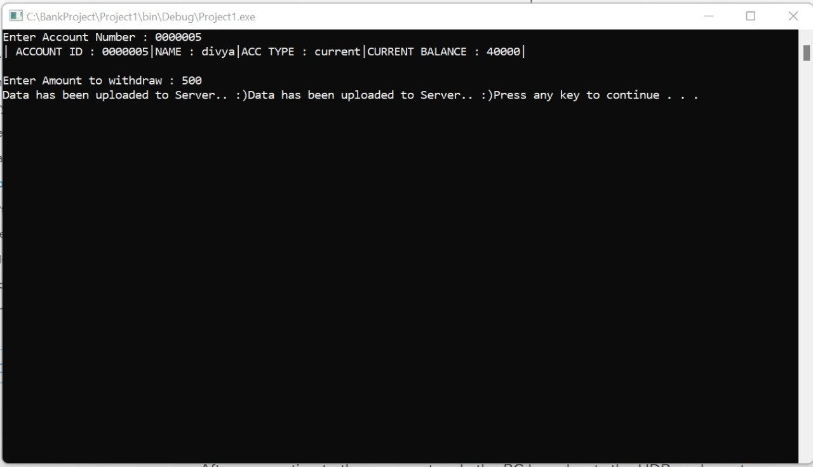
Amount Withdraw

Slide 19
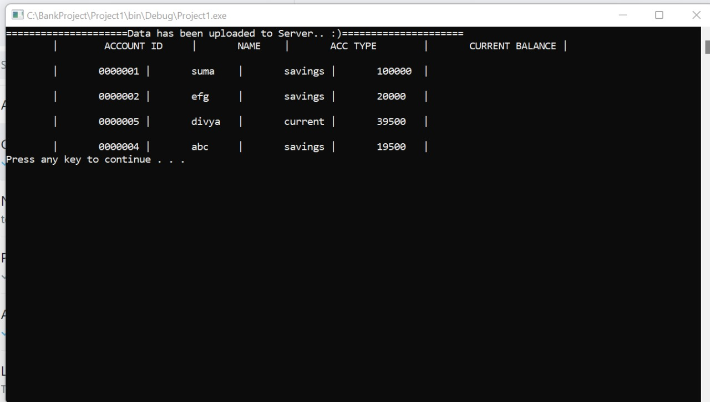
Account Holder List

Slide 20
CONCLUSION
The goal of this research was to create a bank management project system that would aid in the maintenance of bank users’ records. It has the ability to handle all the transactions done with the client’s financial matters. The project must have tight security to secure the financial records of all the bank clients.
That ends our elaboration on Bank Management System Project Report and documentation.

Slide 21
THANK YOU!
Team Members-
Ashok Kumar
Chinmay M
Raghu H S
M. Suma Rani

